Slide 1
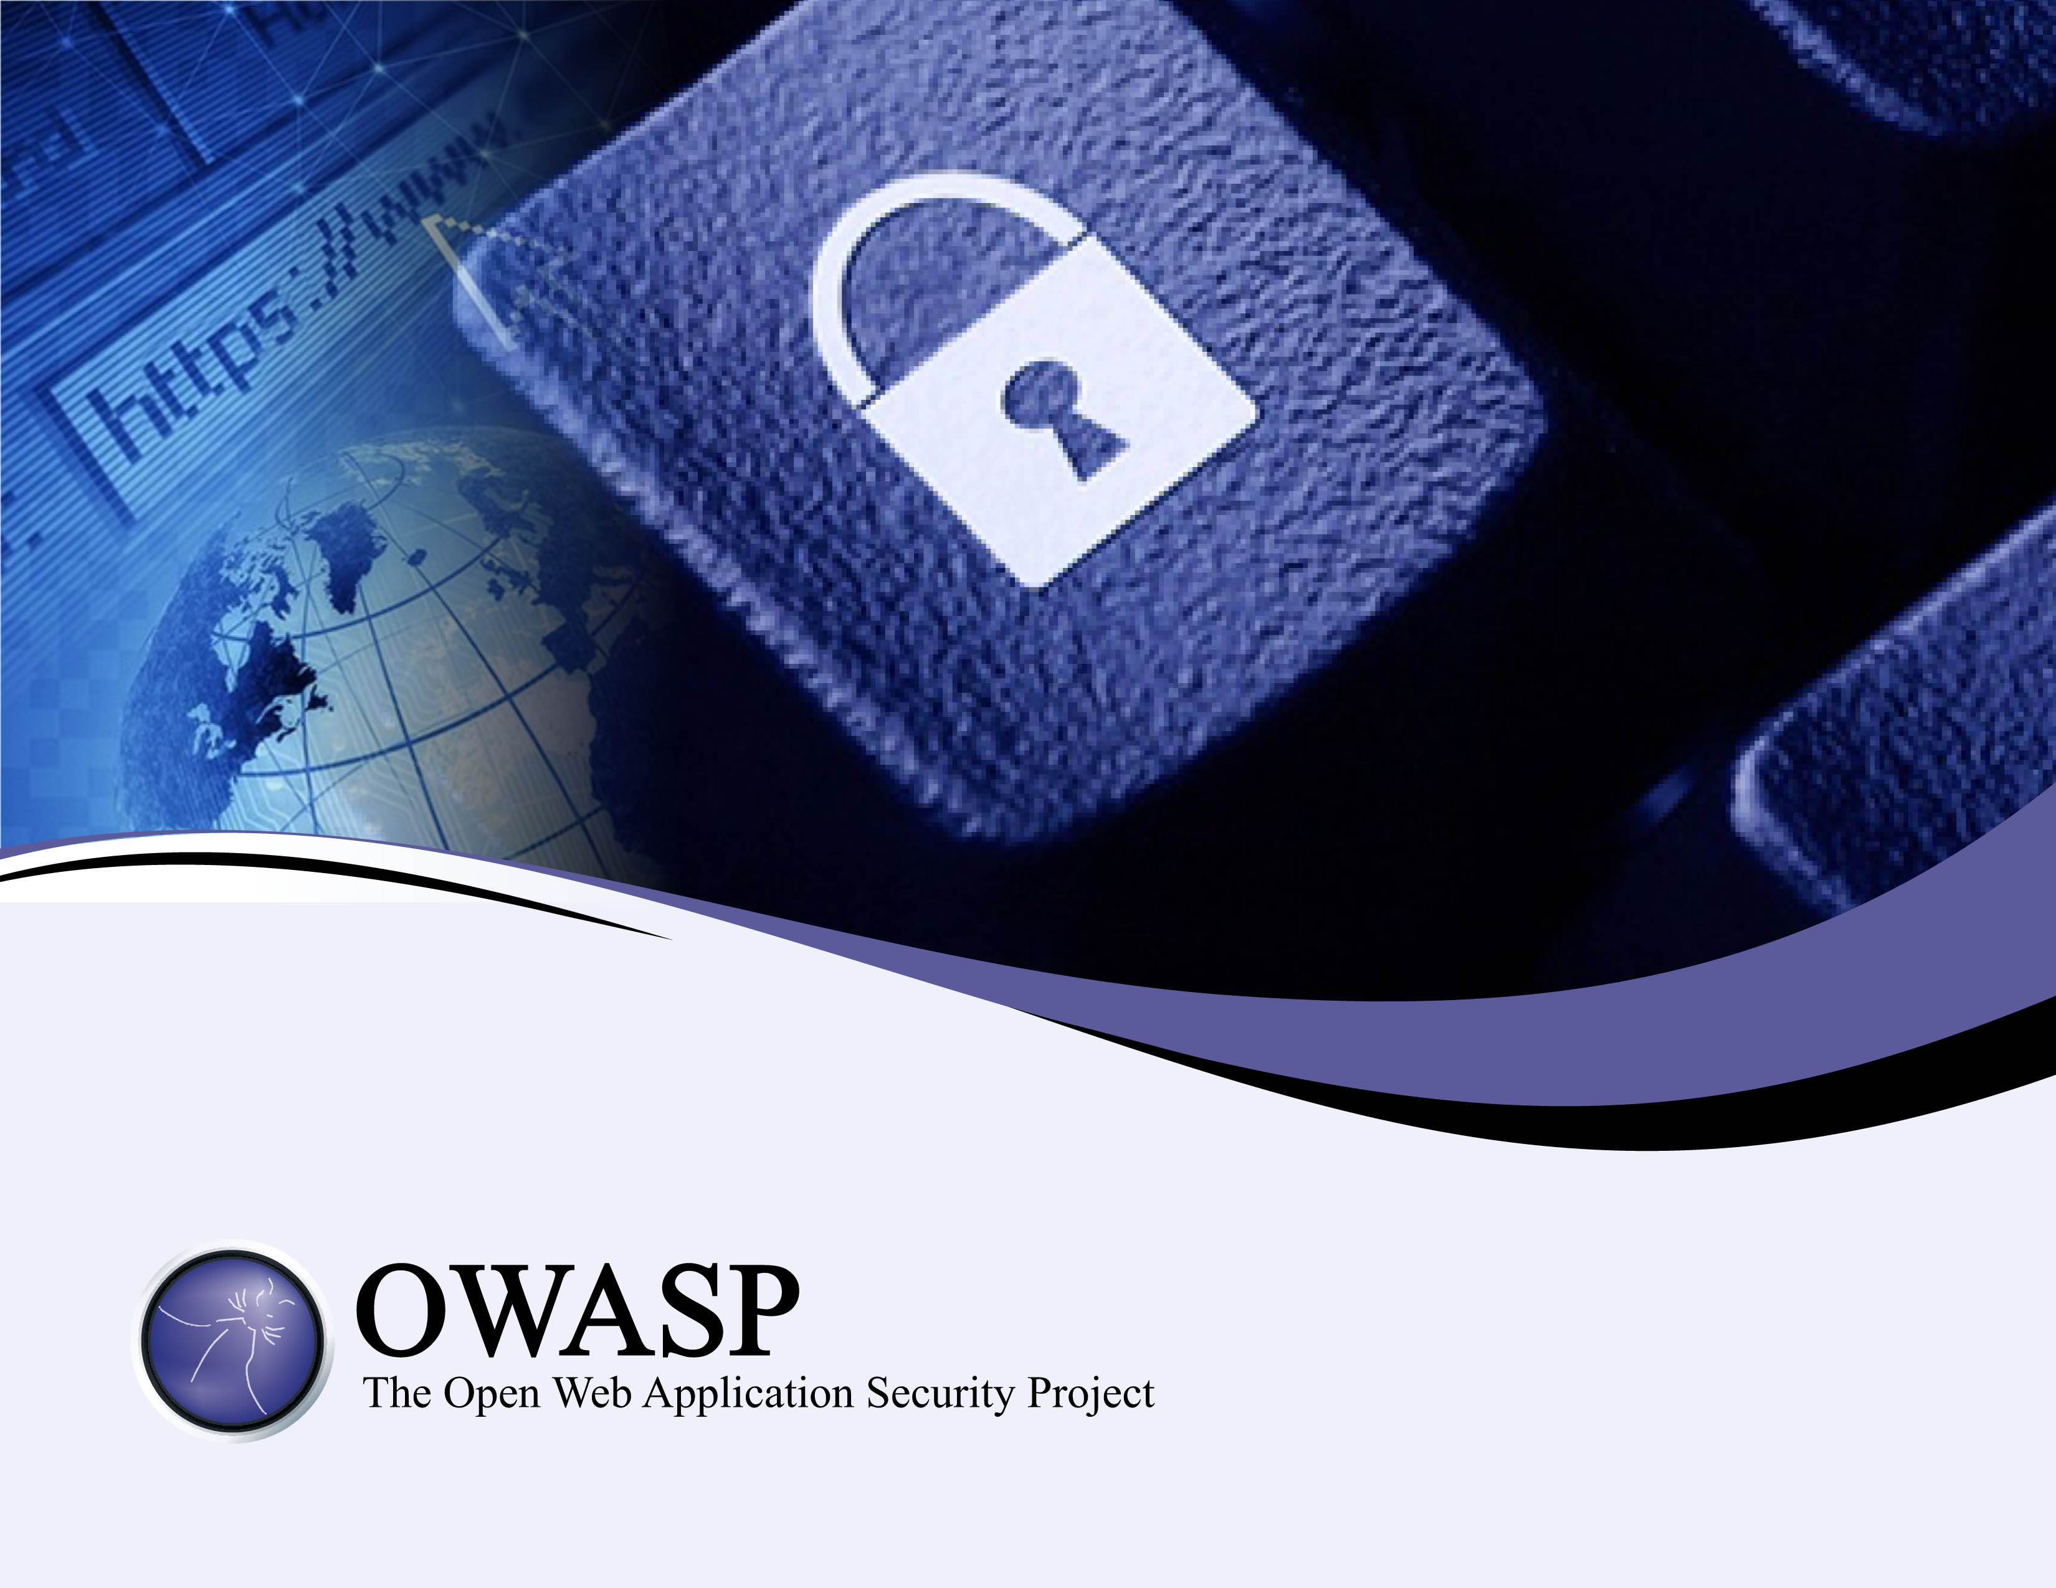
The Concept of Web Knocking and a Tool to Go With It
The OWASP WebSpa Project (Incubator Project) Mar 2014

Slide 2
About Me
Yiannis Pavlosoglou (https://www.owasp.org/index.php/User:Yiannis)
There is a world of numbers, hiding behind letters, inside computers, this is what stimulates my work. I am currently employed in IT risk management within the financial industry, running a team of technical risk assessors. Prior to this, I spent 5 years in the world of professional penetration testing. I focused my career evolution on assisting large scale projects actually implement secure development practices. This included teaching developers how to write secure code. For OWASP, I was the project leader for JBroFuzz and used to chair the Global Industry Committee. I am on the Application Security Advisory Board of the (ISC)2. My academic qualifications include a PhD in information security, designing routing protocols for ad-hoc networks. I am a certified scrum master and hold the CISSP certification.
Application Security
2011 - Web-Spa Single Request Authorisation Web Knocking
2011 - Port Knocking Web Implementations Ideas for more ports
2011 - Swiss Cyber Storm Protecting Web Applications through Port Knocking
2009 - WebGoat Off-By-One Lesson WebGoat Off-By-One Lesson Remains to be Published
OWASP Life in Bullets:
2010 - Bletchley Park ISSA UK Hacking for Queen and Country
2010 - OWASP GitHub http://www.owasp.org/index.php/Category:OWASP_GitHub
2010 - OWASP London http://www.owasp.org/index.php/London#Thursday.2C_January_14th_2010
Penetration Testing with Selenium
2009 - OWASP Global Industry Committee http://www.owasp.org/index.php/Global_Industry_Committee
2008 - OWASP NYC Conference http://video.google.com/videoplay?docid=-1551704659206071145#
JBroFuzz - Building a Java Fuzzer
2008 - Deepsec Vienna http://2008.deepsec.net/
Hybrid Code Auditing: A Dataflow Source Code Review Methodology
2007 - OWASP New York/New Jersey http://www.owasp.org/images/4/4e/OWASP_NY_07-Financial-Real-Time-Threats_Pavlosoglou.ppt
Financial Real-Time Threats: Impacting Trading Floor Operations
2006 - JBroFuzz Project Leader http://lists.owasp.org/mailman/listinfo/owasp-jbrofuzz
JBroFuzz Mailing List
Project Involvement
DirBuster - http://www.owasp.org/index.php/Category:OWASP_DirBuster_Project
JBroFuzz - http://www.owasp.org/index.php/JBroFuzz
Contact
Yiannis Pavlosoglou yiannis@owasp.

Slide 3
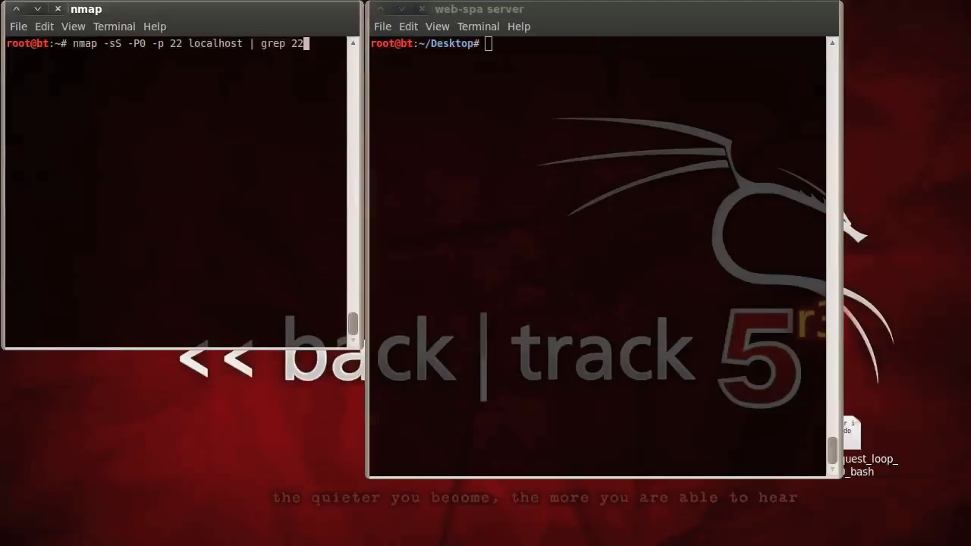
MESSAGE WebSpa07 BEGIN ;

Slide 4
Web Knocking Definition
If port knocking is defined as
"a form of host-to-host communication in which information flows across closed ports"
then we define
web knocking a form of host-to-host communication in which information flows across erroneous URLs.

Slide 5


Web Knocking Use Case
Browses Website
<<includes>>
Check for Valid Web-Spa Request
<<system>>
Website
User
Run O/S Command
<<extends>>
Enable Website
Hidden
Functionality
View / Manage
Users & Actions
Set Unique Pass-Phrase & Actions
Web-Spa
User
Web-Spa Administrator

Slide 6
WebSpa Message Format
24 bytes – substring_{(0,20)}{ SHA-512¹⁰²⁴{pass-phrase ,action, time, random_{4 bytes} } } – random_{4 bytes}
51 bytes – substring_{(0,50)}{ SHA-512¹⁰²⁴{pass-phrase , time, random_{1 byte} } } – random_{1 byte}
http://localhost/Ajf0hP(…)UvXPA_FaY5oYsO3ttC0zePbYmdd3l(…)PHls2dka3YDl4Q_o
75 bytes – Request Length: 100 Characters

Slide 7
WebSpa Functional Block Diagram
O/S Command Source
Action
Pass-phrase
SHA-512
Base64 Encode
CLN
HTTP/S
UTC time (minutes)
Synchronisation
O/S Command Sink
Command
User
SHA-512
Base64 Decode
SRV

Slide 8
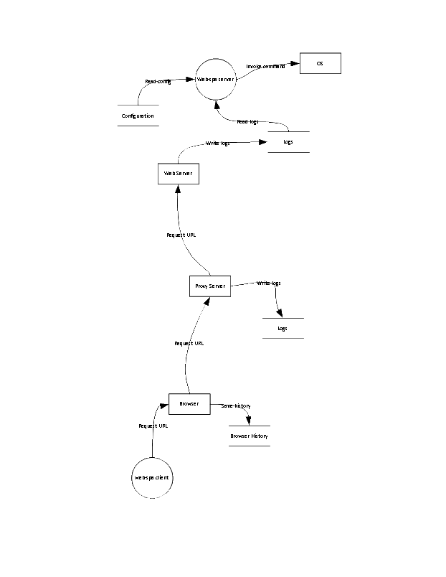
WebSpa Data Flow Diagram

Slide 9
WebSpa Attack Trees (1/2)
Goal 1: Execute an O/S Command on a server running web-spa
1. Decrypt the web-knock message itself (OR) 1.1. Break hash commit operation (OR)
1.1.1. Brute-force hash commit operation (OR) 1.1.2. Mathematically break hash commit operation (OR)
1.1.2.1. Break SHA-512 (OR)
1.1.2.2. Break partial SHA-512 substring used (OR)
2. Determine pass-phrase or action used to generate the web-knock via other means (OR)
2.1. Fool web-spa user into sending their pass-phrase into the clear (OR) 2.1.1. Convince the web-spa user to use a fake web-spa client (OR)
2.2. Monitor the memory of the computer where the web-spa client is used (OR) 2.3. Monitor the memory of the computer where the web-spa server is used (OR) 2.4. Implant virus that exposes the pass-phrase and action number (OR)
3. Get the web-spa administrator to (help) decrypt the message (OR) 3.1. Chosen ciphertext attack on the web-knock (OR) 3.2. Send another user’s pass-phrase and action number (OR) 3.3. Read web-spa server database
3.3.1. Copy database off the administrator’s hard drive or virtual memory (OR)
3.3.2. Copy database from back locations (OR)
3.3.3. Monitor administator’s network traffic (OR)
3.3.4. Use electromagnetic/wireless snooping techniques to read messages as it is displayed on the screen (OR)
3.4. Compromise the ’out-of-band’ channel of communication used between the web-spa user and administrator

Slide 10
WebSpa Attack Trees (2/2)
Goal 2: Make a server running web-spa unresponsive to all requests
1. Crash the server so that to force access via an insecure channel (OR)
1.1. Send so many requests that the web server becomes unresponsive (OR)
1.2. Send so many web-spa requests that the web-spa server becomes unresponsive (OR)
1.2.1. Create a valid web-knock from an active user’s pass-phrase and action number that is submitted repeatedly to the web-spa server (OR)
1.2.2. Create invalid web-knock requests that pass the basic input validation tests and submit them repeatedly to the web-spa server (OR)
In the event of not knowing which server to attack, a determined attacker would have to be able to identify a web-spa server first.
Goal 3: Identify a server that is running web-spa
1. Periodically monitor a server for changes in its services (OR)
2. Compromise a server and find the respective web-spa server executable, database and configuration files on it

Slide 11
WebSpa Attack Scenarios
Scenario 1 (S.01): The attacker obtains a valid Request from the Proxy Server's Logs and cracks the Request to recover a valid password;
Scenario 2 (S.02): The attacker obtains a valid Request from the Web Server's Logs and cracks the Request to recover a valid password;
Scenario 3 (S.03): The attacker modifies network traffic to direct a valid request to server under his control to obtain a valid Request and cracks the Request to recover a valid password;
Scenario 4 (S.04): The attacker obtains a valid Request from the network traffic and cracks the Request to recover a valid password;
Scenario 5 (S.05): The attacker sends a Request to the Web Server and monitors the server locally to check if that Request was successful;
Scenario 6 (S.06): The attacker read the Configuration of web-spa to recover clear text passwords;
Scenario 7 (S.07): The attacker modifies the Configuration to add a user with known password or modify an existing user's password;
Scenario 8 (S.08): The attacker modifies web-spa binary itself;
Scenario 9 (S.09): The attacker captures a valid Request and sends it to the server (replay attack).

Slide 12
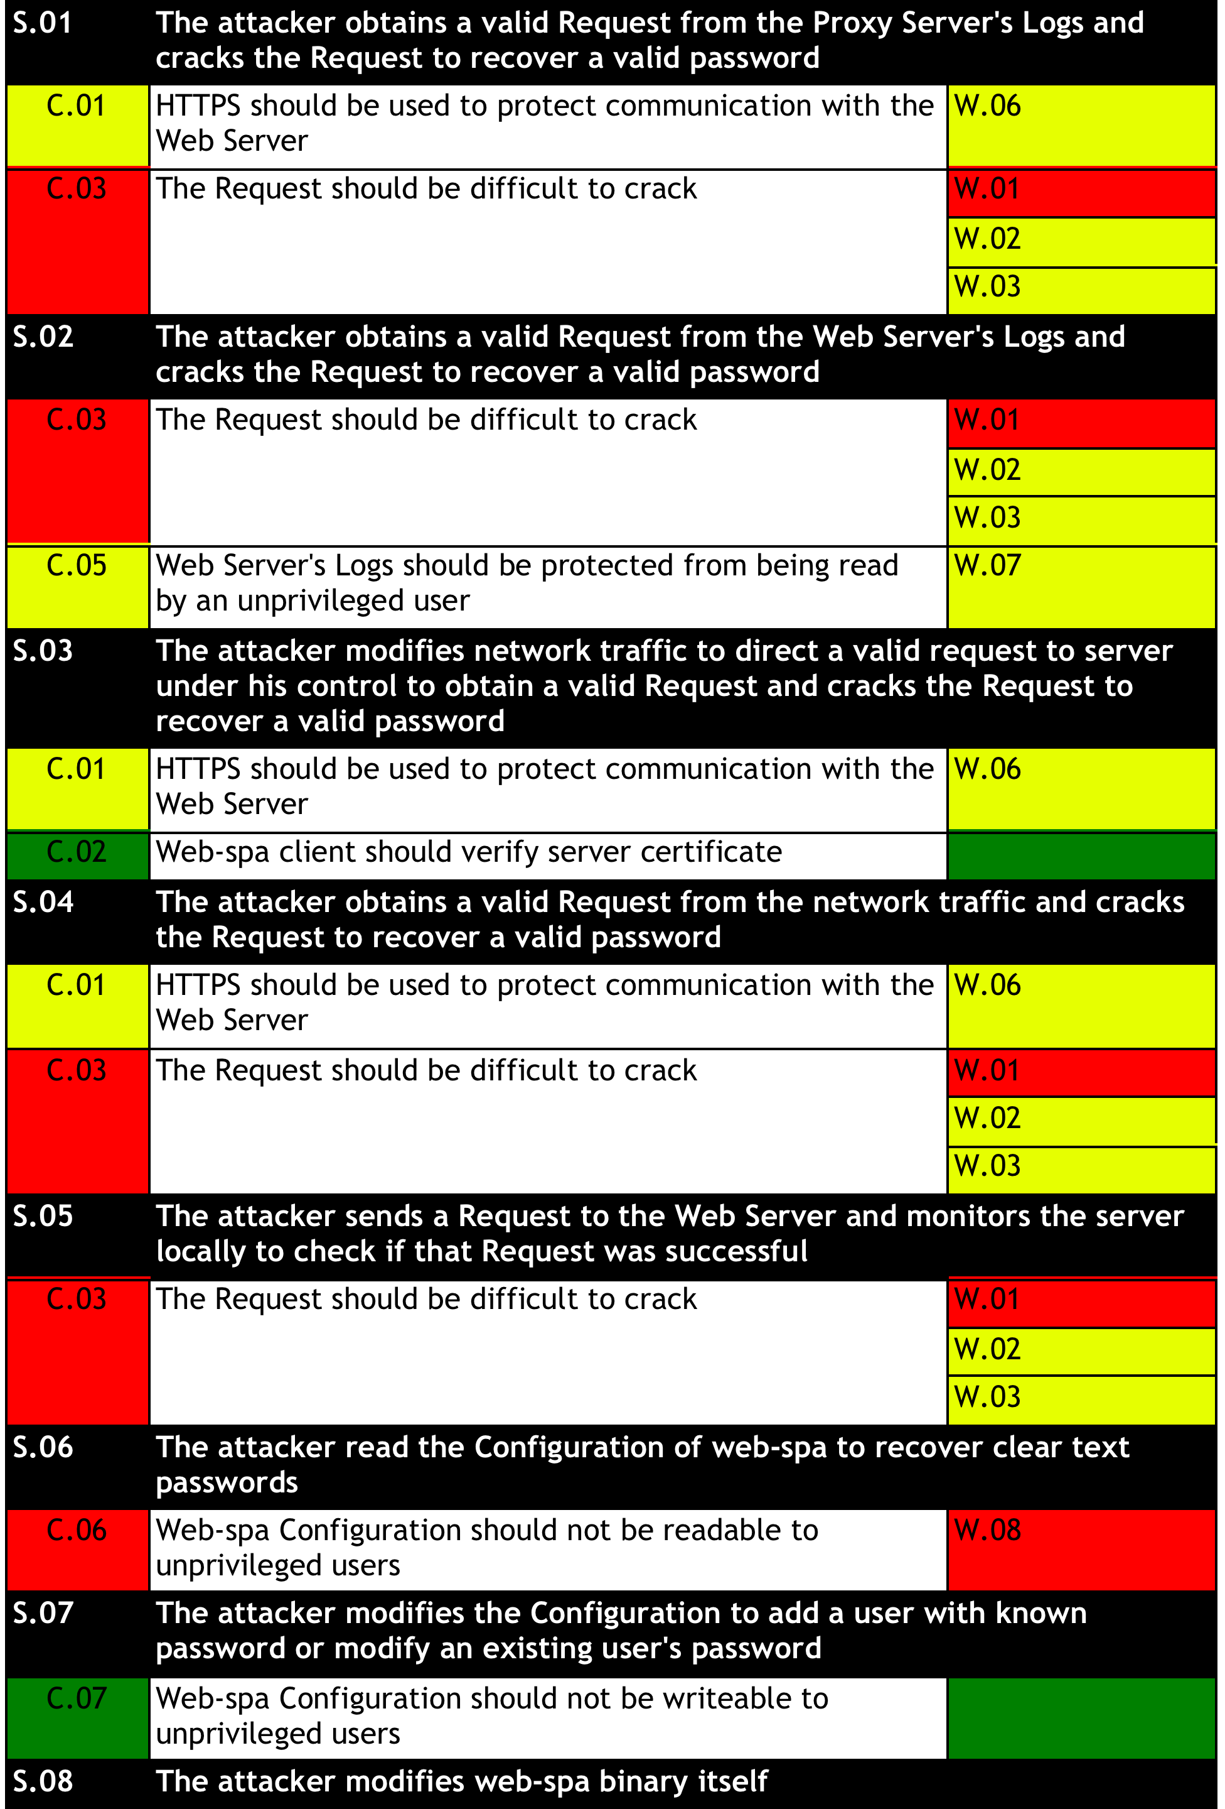
WebSpa Weaknesses & Countermeasures

Slide 13
WebSpa Documentation
The discrepant event discussed herein is web knocking. Within the latest download you can find three documents with the purpose of describing how WebSpa can be used. The three documents are:
WebSpa Administration Guide This document describes how to setup and use the server component. It details how to create new users and add new action numbers with respective O/S commands assigned to them
WebSpa Specification Guide This document describes the actual design detailing the use case, specification, requirements and actual attacks, which this tool has been engineered to withstand
WebSpa User Guide This document describes how to use the client for issuing commands through a URL request to a web server
The administration guide aims to enable anyone who would be interested in using WebSpa to be able to setup the server side component of it. After configuring the server component of WebSpa, you'll be ready to use the corresponding client for issuing direct actions as O/S commands to it.
If this is your first time using WebSpa, please note that the server operations described in this document, will not work if a WebSpa client does not submit a web-knock to your web server in a timely manner.
Thus, knowing a client implementation goes hand-in-hand with a server instance for it, please also have a look at the WebSpa user guide document to see how the two can be used in tandem.
The user guide aims to enable anyone who would be interested in using web-spa to do so. As soon as you install the server side component and decide what actions to allow, you'll be ready to use the corresponding client for issuing direct actions that work for you.
Finally, the specification guide aims to enable anyone who would be interested in implementing their own version of WebSpa to do so.

Slide 14
MESSAGE WebSpa07 END;

Slide 15
Thank You!
Oliver Merki
Leader & Operations
Yiannis Pavlosoglou
Inception & Development
Patryk Arciszewski
Theoretician & Documentation
Paweł Goleń
Breaking & Infrastructure
Markus Miedaner
Retired & Happy
[04 Mar 2014] The WebSpa podcast has now been available!
[22 Feb 2014] Created the WebSpa project on sourceforge, started the import from google code
[22 Dec 2013] Version 0.6 has been released and can be found in the download section
[08 Nov 2013] The OWASP Web Knocking Project is created
https://www.owasp.org/index.php/OWASP_WebSpa_Project

